Slide 1
Simplify MLOps for Everyone
Hackathon FY 22

Slide 2
Ideation
Challenges Present Today
Possible Resolution Hacks
Current process is cumbersome
MLops process are not matured and maturing
Missing Role Clarity
Training, Retraining and inference process are not clear
Continuous improvement is required
Monitoring performance and validation are required
MlOps Challenge - Link
Create a simplified process
Build accelerator
Can we use Hand gesture to trigger mlops
Can we use voice to trigger mlops
Completely automated process
Can we use that as hackathons for customer
Can we make it part of innovation lab

Slide 3
Data Science Development process

Slide 4
Training Pipeline Automation

Slide 5
Deploy

Slide 6
MLOps

Slide 7
Customer IT Teams Involved
Networking
Security
Strategy/EA
Technical Architecture
Solution Architecture
DevOps/Release
Management
Planning
Budget
Business Analyst

Slide 8
Customer Data Science Team
Data engineers
Data scientists
AI engineers – writing code for devops
AI/ML Architecture
AI/ML Business Analyst
SME – Usually business folks based on use case
Directory
CDO

Slide 9






How the roles function in - Customer
RACI
 | Data Scientist | Business SME | Data Engineer | Business Owner | ML Engineer/CI/CD | IT – Azure/ Security
Data Engineering
ML Model
Prod Code
MLOps
Business analyst/ Validate
Prod Deploy
RACI
C
C
R
I
I
R
I
A
I
I
Matrix
I
I
C
I
R
I
If you take a look at the RACI chart for EDSP you’ll notice two things immediately – first, the Account team is involved in every stage in the process, they should never be kept out of the loop. Second, accountability for the process is spread across several different roles, so teamwork and communication is essential. Although there are certain prescribed points information handoff, this process will work best with non-sensitive information being granted as freely as possible to all involved.
I
A
I
R
C
I
R
A
C
I
C
A
Responsible
Accountable
Consulted
Informed
Notes:
Customer Resources for EDSP to be successful
Roles are all from customer side
Left side is all functionality or various stages or departments of data science

Slide 10
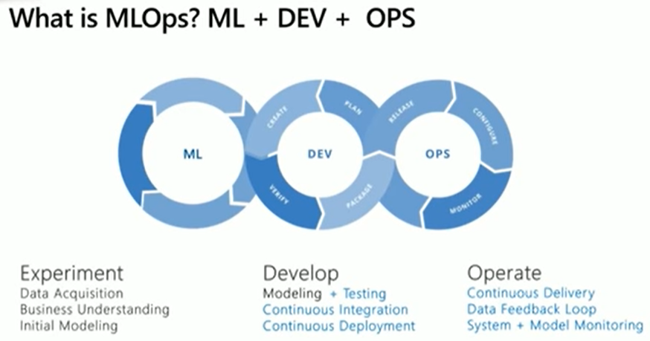

Slide 11
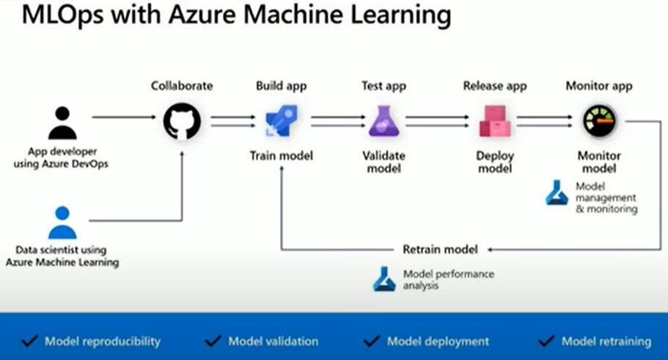
Notes:
(995) Machine Learning DevOps Architecture Guidance - YouTube

Slide 12
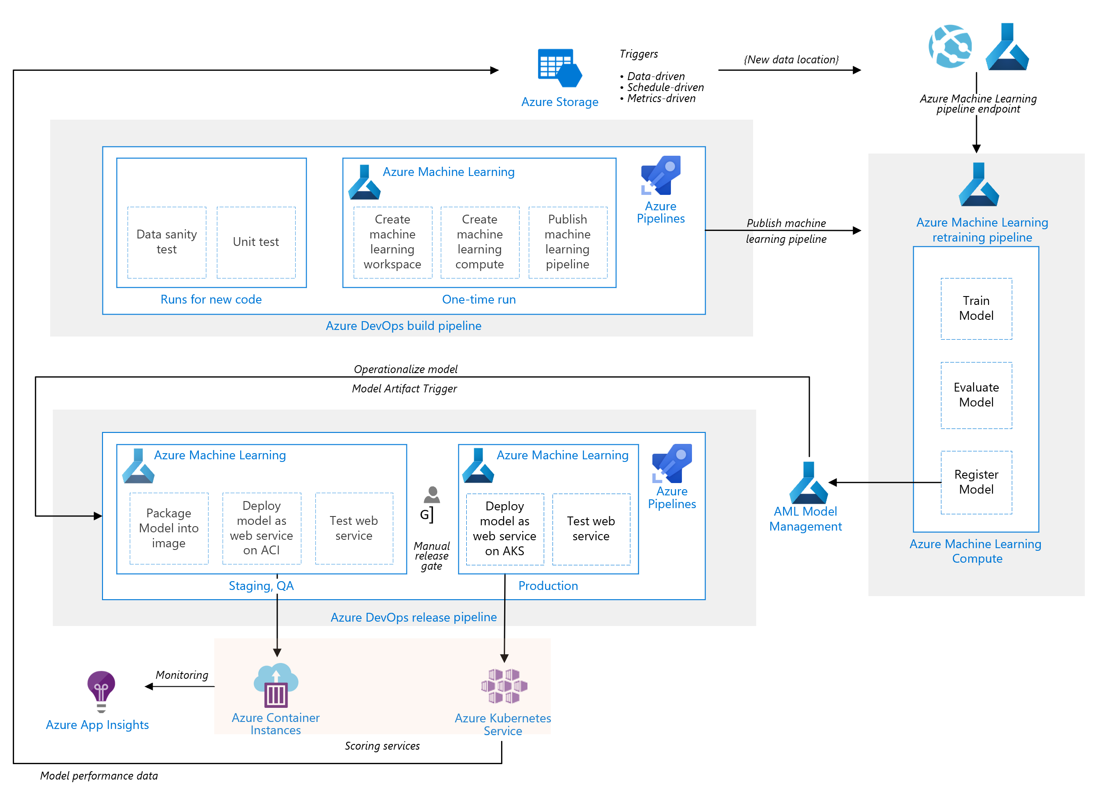

Slide 13
Raw Data
Data Ingestion Pipeline
Ingest
Process
Serv
Processed Data
AML Pipeline
Dataset
Train
Evaluate
Register
Model Registry
Deploy Model
Scoring Image
ACI
Repo
DevOps Pipeline (Model Training CI)
Code Quality Check
Unit Tests
Build AML Pipeline
Publish AML Pipeline
Run AML Pipeline
Run Model Deployment
DevOps Pipeline (Environment CI)
ML Workspace creation
Notes:
DataOps for the modern data warehouse - Azure Architecture Center | Microsoft Docs
Data ingestion with Azure Data Factory - Azure Machine Learning | Microsoft Docs
MLOps for Python with Machine Learning - Azure Reference Architectures | Microsoft Docs

Slide 14
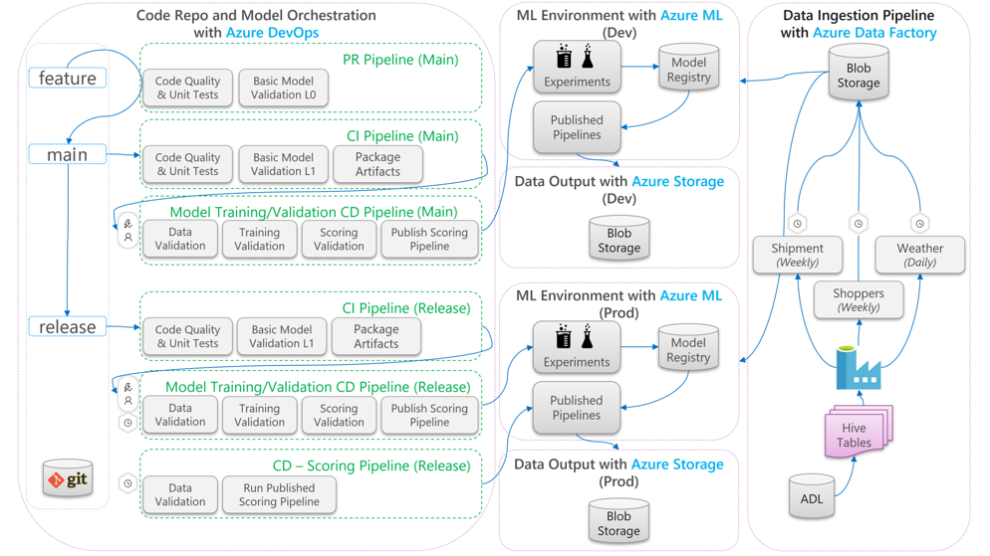
link

Slide 15
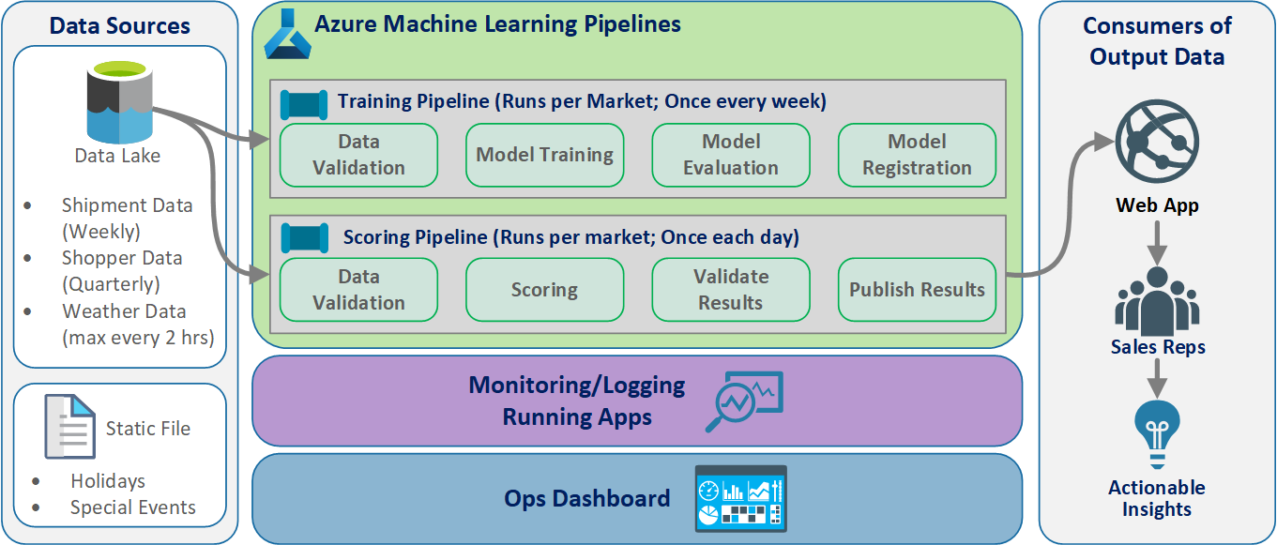

Slide 16









Why Synapse Enterprise Grade-ML
Model Development / Training
Productizing AI
Analytic Systems
Train in the cloud within the Hub
Scoring with operational systems
Governance everywhere (models, lineage)
Ethical AI
Control over deployment
Deployment across Apps, BI, Processes
Exchange of models (ONNX)
Enabling Reinforcement learning
Featurization
Model Training
Model
Model
Optimization
Power Apps
Power Automate
Power BI
AI
Offline Featurization
Deployment
Offline
Online
Model Scoring
Data Lakes
IoT
App Data
Files
SaaS
Data Variety
Policies
Featurization
Model
GOVERNANCE & COMPLIANCE

Slide 17



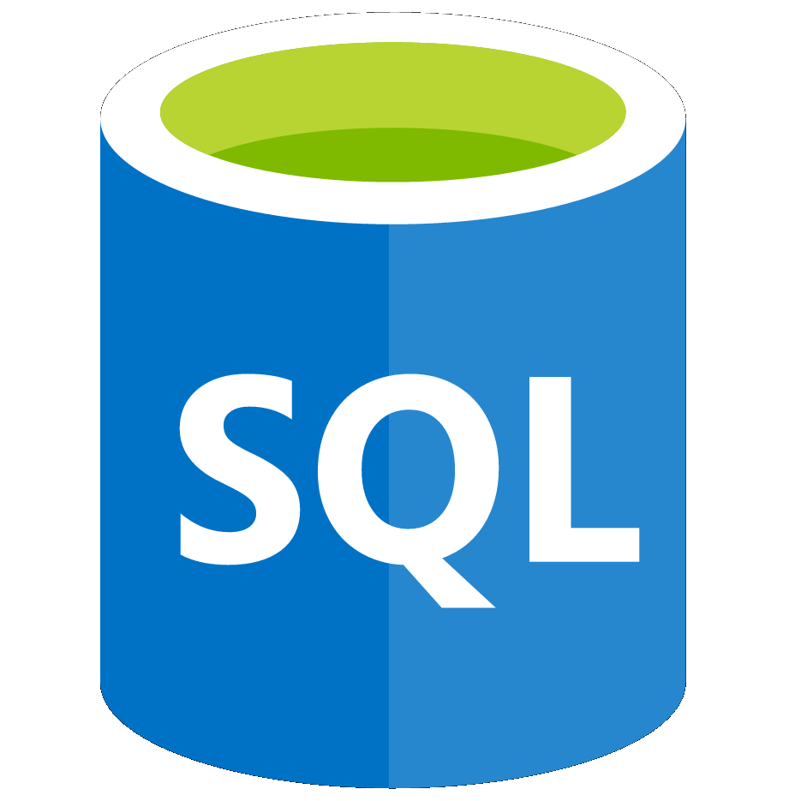



Azure Synapse Analytics
The first unified, cloud native platform for converged analytics
Unified Experience
Azure Synapse Studio
On-prem
Integration
Management
Monitoring
Security
DevOps
Cloud data
Analytic runtimes
SQL
Data Explorer
Applications
Semantic Layer – Common Data Model
Streaming data
Data Warehouse
Data Lake
Event Brokers
Azure Synapse Link
Cosmos DB
Dataverse
Notes:
Azure Synapse unifies your data, your data tasks, and your data teams with a limitless analytics service that does it all. This is the result of a multi-year effort.
We set out to rearchitect and create the next generation of query processing and data management with Synapse to meet the needs of the modern, high scale, volume, velocity, and variety of data workloads.
As these modern workloads require both SQL and Apache Spark, we saw that customers would need a cloud-native analytics service engine that converged big data and data warehousing so they could achieve limitless scale on structured, semi-structured, and un-structured data.

Slide 18
Process involved in MLOps
Define use case
Collect Data Sources
Document Data sources – Data dictionary
Data engineering
Data Science modelling
Validate if use case/data has possibility to continue
Create code for MLOps
Training code
Evaluate code
Register model
Batch/Realtime inferencing code, AKS,ACS, Batch
Create DevOps Pipeline to push through environment
Store Data engineered data set – feature store for others to use
Document the entire Data science process
Setup Monitoring for Model inferencing and –Re-Training
Dashboard on Model performance
Deploy model to model marketplace – Sharable for other inside enterprise
Customer support

Slide 19
MLOps Technology Task
Architecture/Security approval
Networking to connect to enterprise data
Design and Implementation Guidelines
Data Science Development environment
For Data engineer/ data scientists/ AI engineer
DevOps/MLOps Dev, QA and Prod environments
Build Each Environment Pipeline – Generalized
Security on all the environments
Design and Implementation guide
Dependent system – Design and implementation guidelines
Monitor – for ML Operations – AOC – Analytics operation center
Backup and restore
HA/DR
Performance
Cost
Timeline and budget
Customer support

Slide 20
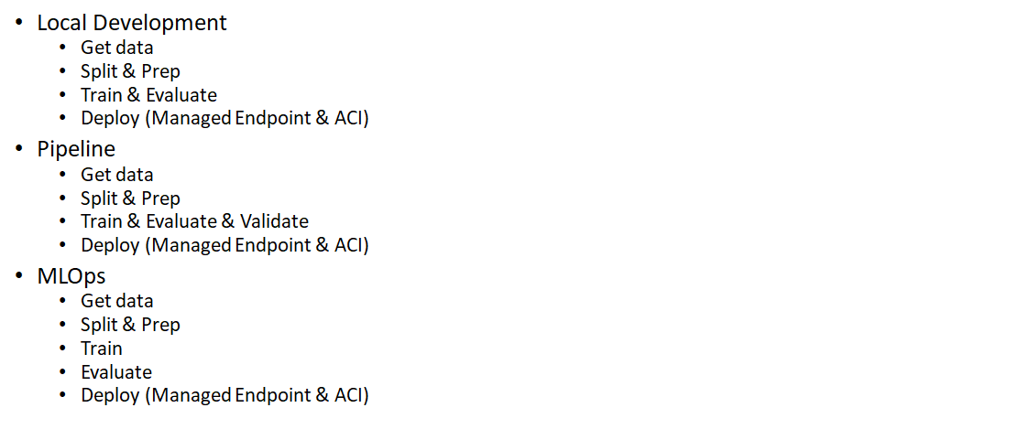
Basic Model Development

Slide 21
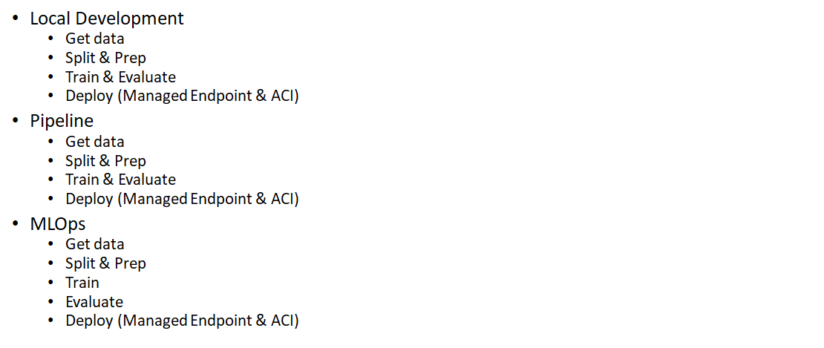
AutoML Model Developent

Slide 22
Challenges
Azure ML Designer – MLOps
We do have a team – let’s use them
Simple Model – Yes
Conceptualize/Framework – high level End to End flow - Yes

Slide 23
MLOps Teams Involved
Infrastructure
Data Science/ML
Data engineer

Slide 24
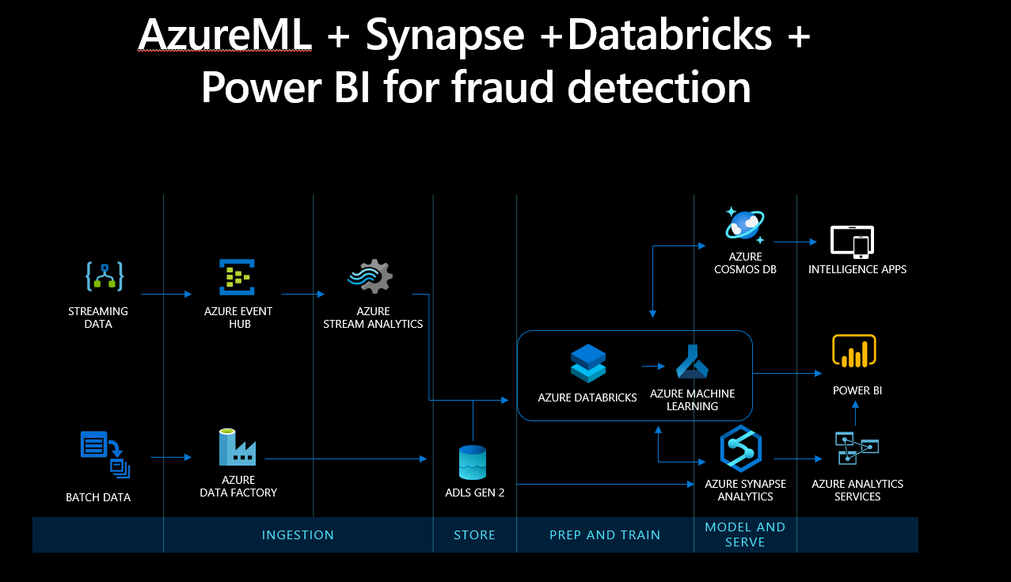

Slide 25
Teams
Conceptualize/Framework – high level End to End flow – Yes
Meer/Jonathan/Dong/Atanu/Vandana
Simple Model
Megan Masanz
Video/presentation
Bala/Megan/Jonathan
Others

Slide 26
Conceptualize/Framework – high level End to End flow - Yes

Slide 27
Simple Model – Yes

Slide 28
Outcome
Create ML open hack
Build Solution Accelerator
Single Click deployable solution(Subject to customer review)
Document the Security and process for above accelerator
Deploy with customers – KPI (How many deployed)

